Slide 1
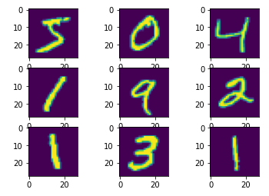
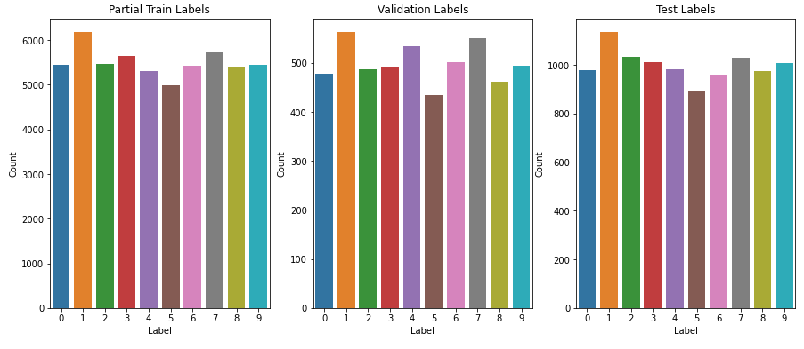
Sample Images
Distribution of Classes Across Datasets

Slide 2
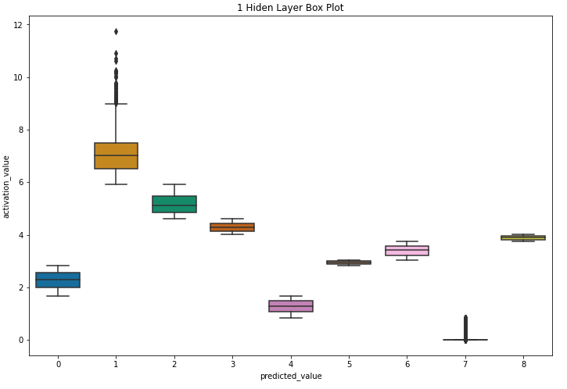
Experiment 1 Activation Values vs Predicate Value Boxplot

Slide 3
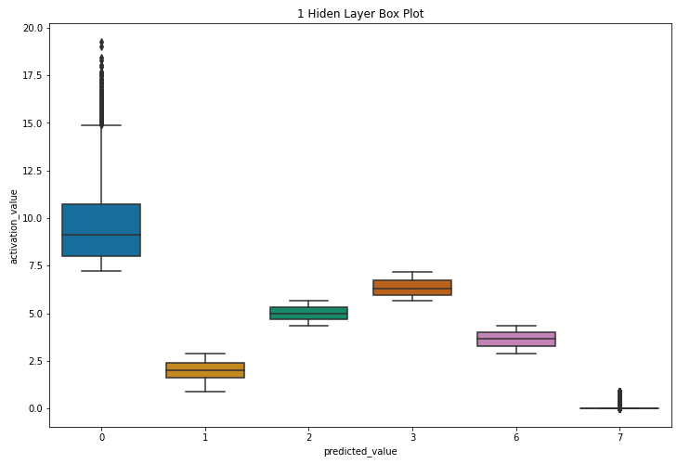
Experiment 1 Activation Values vs Predicate Value Boxplot

Slide 4
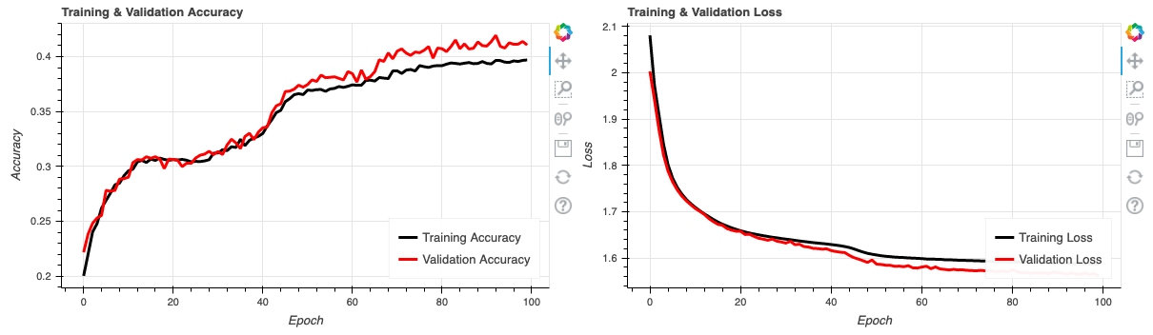
Experiment 1 Results (Accuracy and Loss of Training and Validation Datasets)

Slide 5
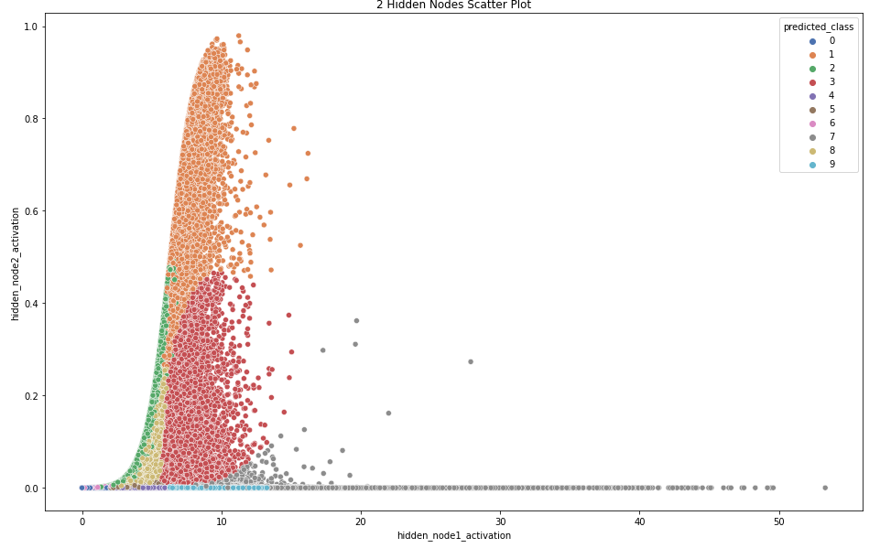
Experiment 2 Activation Values Scatter Plot of Hidden Node 1 and 2

Slide 6
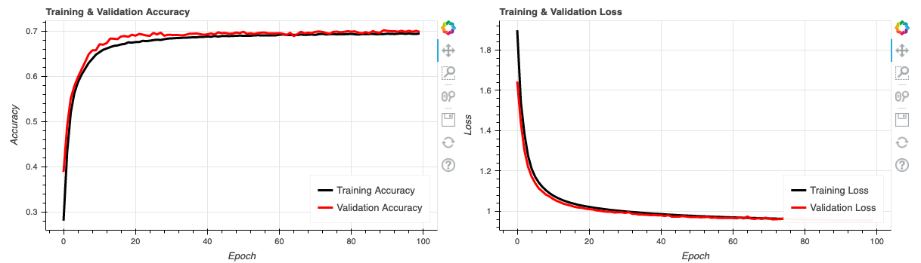
Experiment 2 Results (Accuracy and Loss of Training and Validation Datasets)

Slide 7
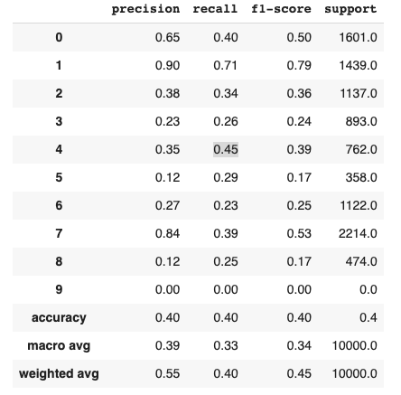
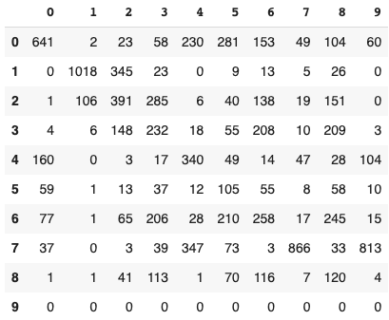
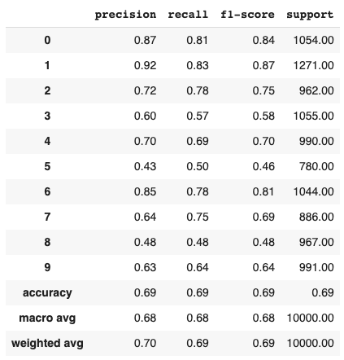
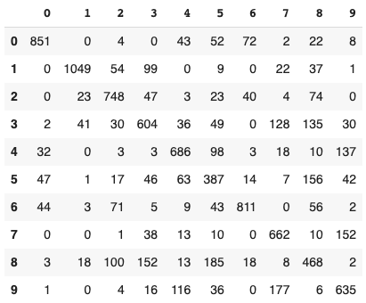
Experiment 1 – Classification Report
Experiment 1 – Confusion Matrix
Experiment 2 – Classification Report
Experiment 2 – Confusion Matrix

Slide 8
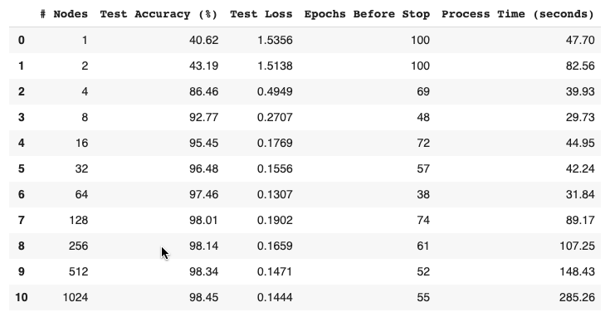
Experiment 3 Trial Results

Slide 9
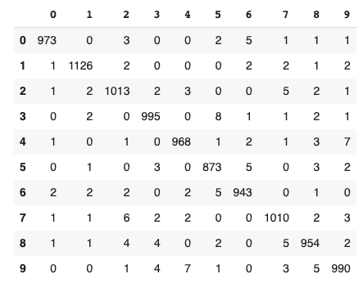
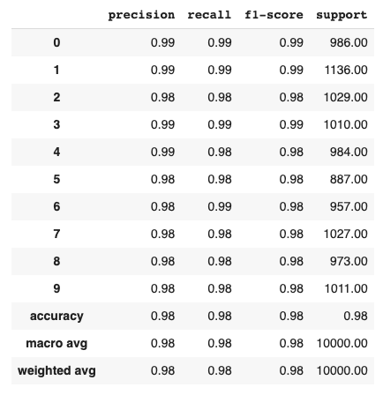
1024 Nodes Confusion Matrix
1024 Nodes Classification Report

Slide 10
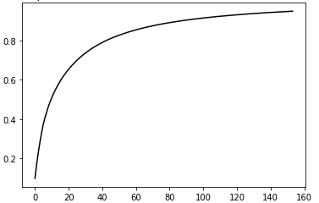
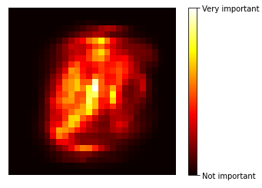
PCA Explained Variance Ratio Based on the Number of Features
Random Forest Most Important Features in the Image

Slide 11
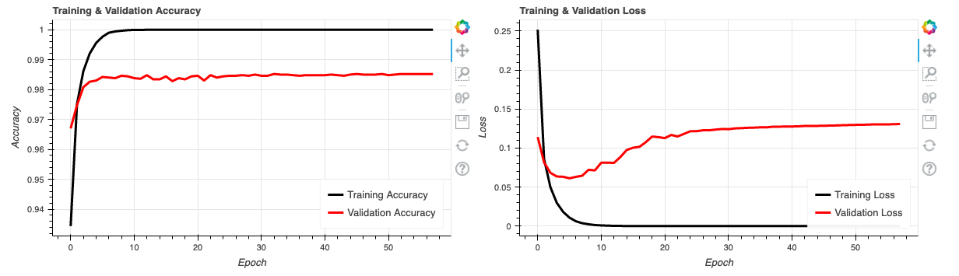
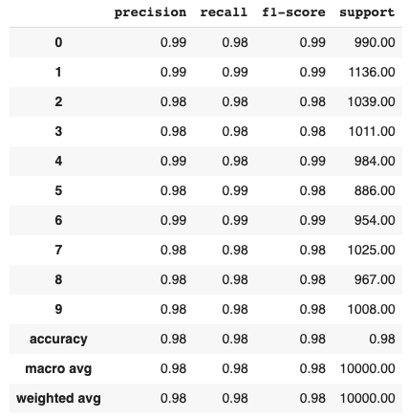
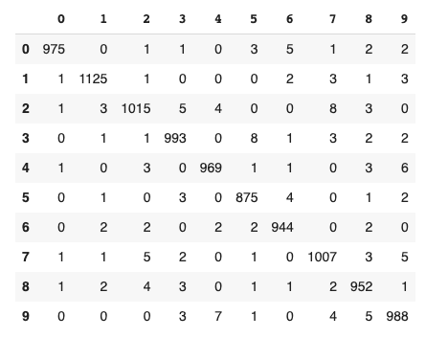
1024 Nodes – Single Layer – PCA Reduction with 95% Variance – Performance
1024 Nodes – Single Layer – PCA Reduction with 95% Variance – Confusion Matrix
1024 Nodes – Single Layer – PCA Reduction with 95% Variance – Classification Report

Slide 12
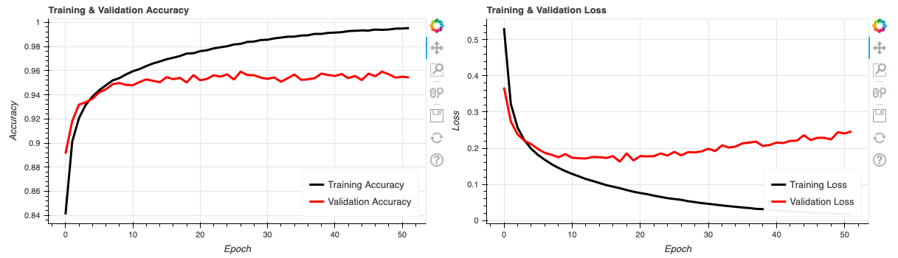
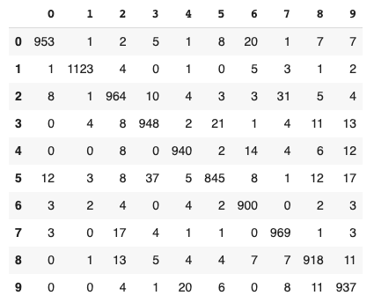
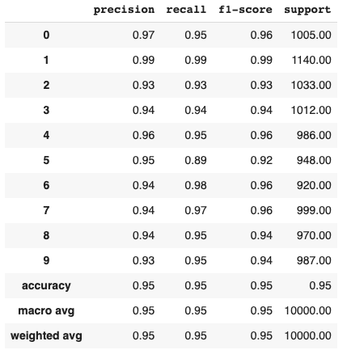
1024 Nodes – Single Layer – Random Forest Feature Reduction – Performance
1024 Nodes – Single Layer – Random Forest Feature Reduction – Confusion Matrix
1024 Nodes – Single Layer – Random Forest Feature Reduction – Classification Report

Slide 13
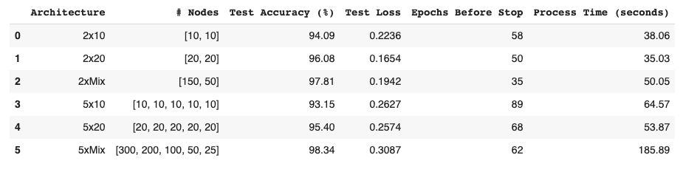
Various Model Architecture Performance on MNIST dataset

